Slide 1
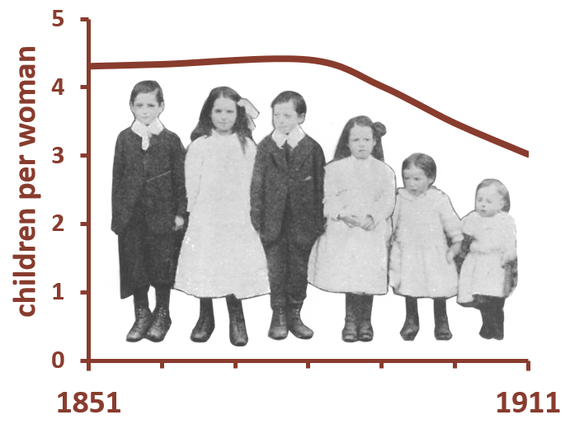
Populations Past: Atlas of Victorian and Edwardian Population
Types of Place Image Gallery

Slide 2
Note about copyright and image re-use
All images are reproduced with permission of the copyright holders, unless images are in the public domain. See image descriptions for further information.
Image date and original source information is provided where known.
Images may be re-used for personal use or class teaching and learning only.
Images may not be re-used for commercial purposes.
Images may not be shared with third parties, placed on websites or shared via social media. Please seek the permission of the copyright holders if you wish to do so.

Slide 3
Definition of Types of Place
Each geographic unit (Registration Sub-District) has been assigned to one of eight types of place based on its occupational structure and population density. The types of place are: AGRICULTURE, SEMI-RURAL, SEMI-PROFESSIONAL, PROFESSIONAL, TEXTILE, MINING, TRANSPORT, and OTHER URBAN.
For each Registration Sub-District (RSD), all economically active men and women (excluding general labourers) aged between 15 and 64 were identified. The percentage of these who worked in different occupational orders was calculated. These percentages have been used to allocate each place as follows:
A place is designated TEXTILE if 25% or more worked in textiles,
Otherwise if 30% or more worked in mining or metal work/manufacture a place is designated MINING,
Otherwise if 7.5% or more worked in the professions (e.g. teaching, medicine, banking) AND 30% or more worked in services a place is designated PROFESSIONAL,
Otherwise if 5% or more worked in agriculture AND the population density was less than 1 person per acre a place is designated AGRICULTURE,
Otherwise if 5% or more worked in agriculture a place is designated SEMI-RURAL,
Otherwise if 15% or more worked in transport a place is designated TRANSPORT,
Otherwise if 7.5% or more worked in the professions a place is designated SEMI-PROFESSIONAL,
Otherwise a place is designated OTHER URBAN.

Slide 4
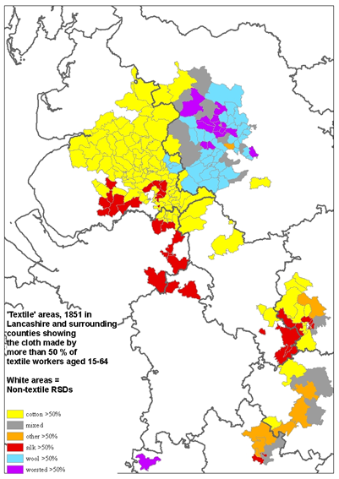
TEXTILE Places
The majority of TEXTILE places were located in East Lancashire and West Yorkshire.
Cotton manufacturing was concentrated in Lancashire, including places such as Bolton, Burnley and Rochdale, whereas the wool industry was dominant in West Yorkshire towns such as Huddersfield and Bradford.
Macclesfield was a centre of the silk industry, and lace-making was common in Nottingham and surrounding areas.
In the mid-19th century there was a significant amount of ribbon-weaving in Coventry, hosiery making in Leicester, and carpet weaving in Axminster, but diversification of industry within these places meant that they were no longer classified as TEXTILE by the end of the period.
The main TEXTILE areas in 1851, showing the cloth made in different areas

Slide 5
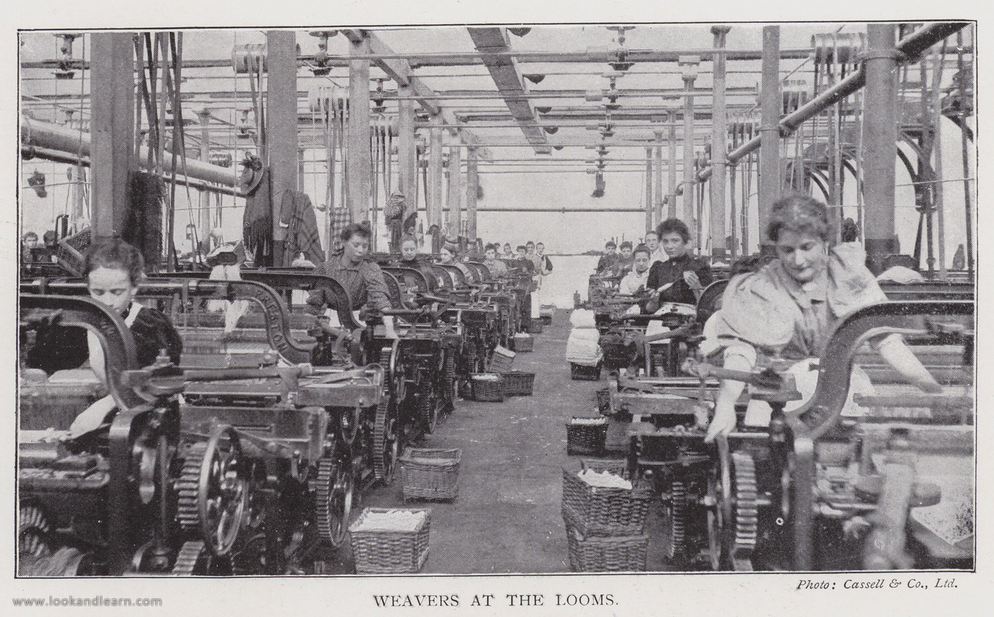
TEXTILE Places 1
Weavers at the looms, 1902.
Illustration for Britain At Work, A Pictorial Description of our National Industries (Cassell, 1902). Credit: Reproduced by permission of Look and Learn History Picture Library www.lookandlearn.com

Slide 6
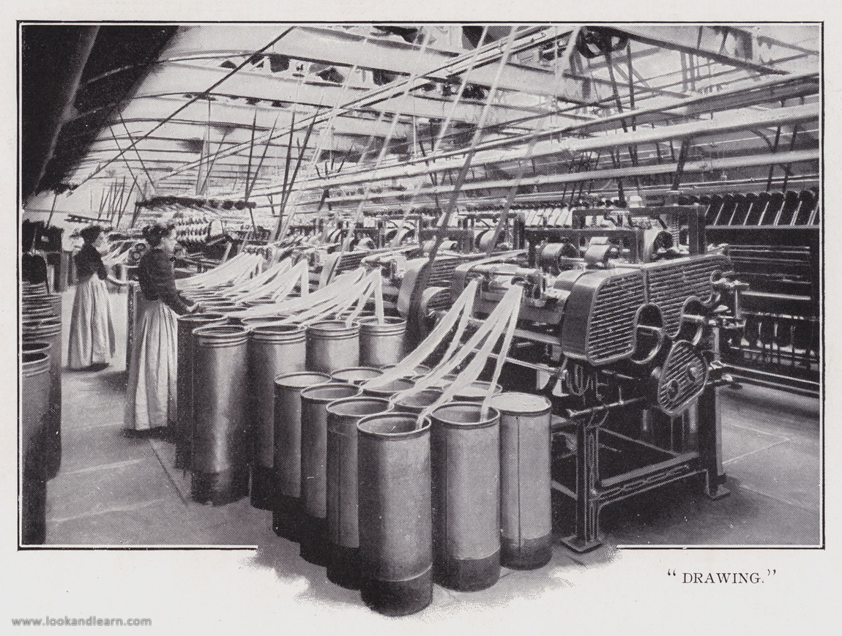
TEXTILE Places 2
Drawing in a woollen factory, 1902. Credit: Reproduced by permission of Look and Learn History Picture Library www.lookandlearn.com

Slide 7
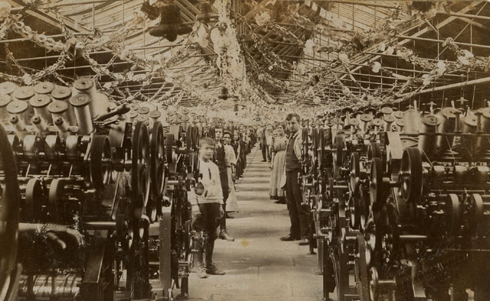
TEXTILE Places 3
Interior Cotton Mill, Shipley, Yorkshire, c. 1900. Public domain. Credit: Postcard collection of Maggie Land Blanck http://maggieblanck.com/Land/WE.html

Slide 8
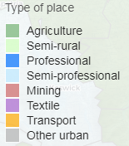
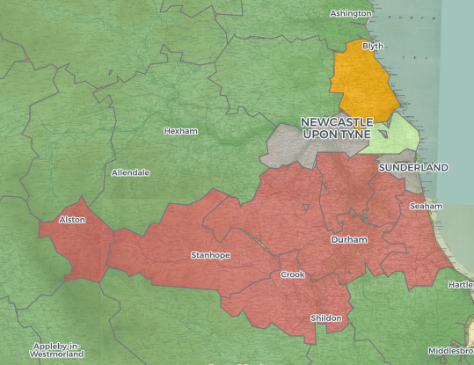
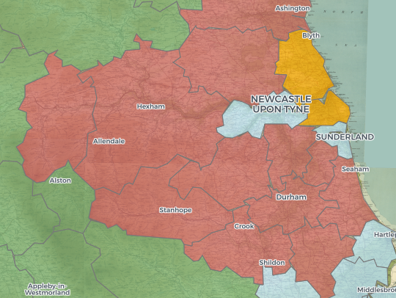
MINING Places
The mining industry was concentrated in the South Wales and Northumberland coal fields, with both areas growing considerably over the second half of the nineteenth century.
In South Wales Merthyr Tydfil and Aberdare were typical mining towns, and in the North East the industry was concentrated in the villages around Newcastle-upon-Tyne, including Ashington and Chester-le-Street. However Newcastle itself was industrially more varied.
Coal mining and metal manufacture also expanded around the South-East Pennines, in places such as Chesterfield, Ilkeston and the area around Barnsley (including Hoyland, illustrated in photograh).
Most of the mining was for coal, but there were small pockets of other sorts of mining and quarrying, such as lead mining in the North Pennines and the Peak District, and tin mining in Cornwall.
1851
1911
The growth of coal mining in the North-East

Slide 9
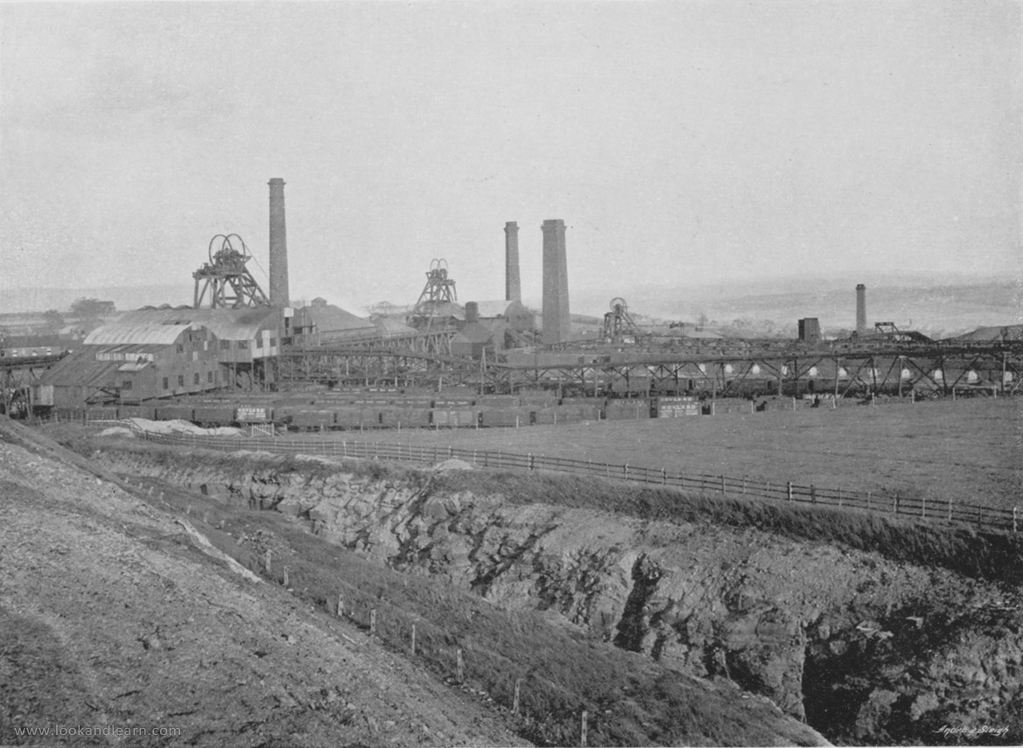
MINING Places 1
Hoyland Silkstone Collieries, Yorkshire, c. 1895. Illustration for Pictorial England and Wales (Cassell, c. 1895). Credit: Reproduced by permission of Look and Learn History Picture Library www.lookandlearn.com

Slide 10
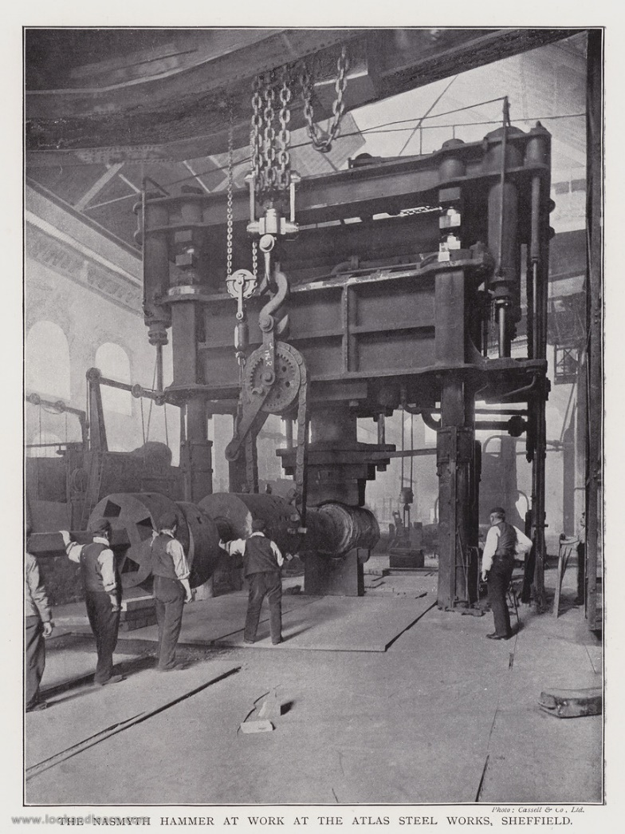
MINING Places 2
The Nasmyth Hammer at work at the Atlas Steel Works, Sheffield, 1902. Illustration for Britain At Work, A Pictorial Description of our National Industries (Cassell, 1902). Credit: Reproduced by permission of Look and Learn History Picture Library www.lookandlearn.com
Notes:
Although Sheffield is famous for its steel works, metal manufacture never dominated enough to place any area of the city in the MINING & metal work category. However we have included this picture of the Atlas Steel Works in Sheffield to illustrate metal manufacture.

Slide 11
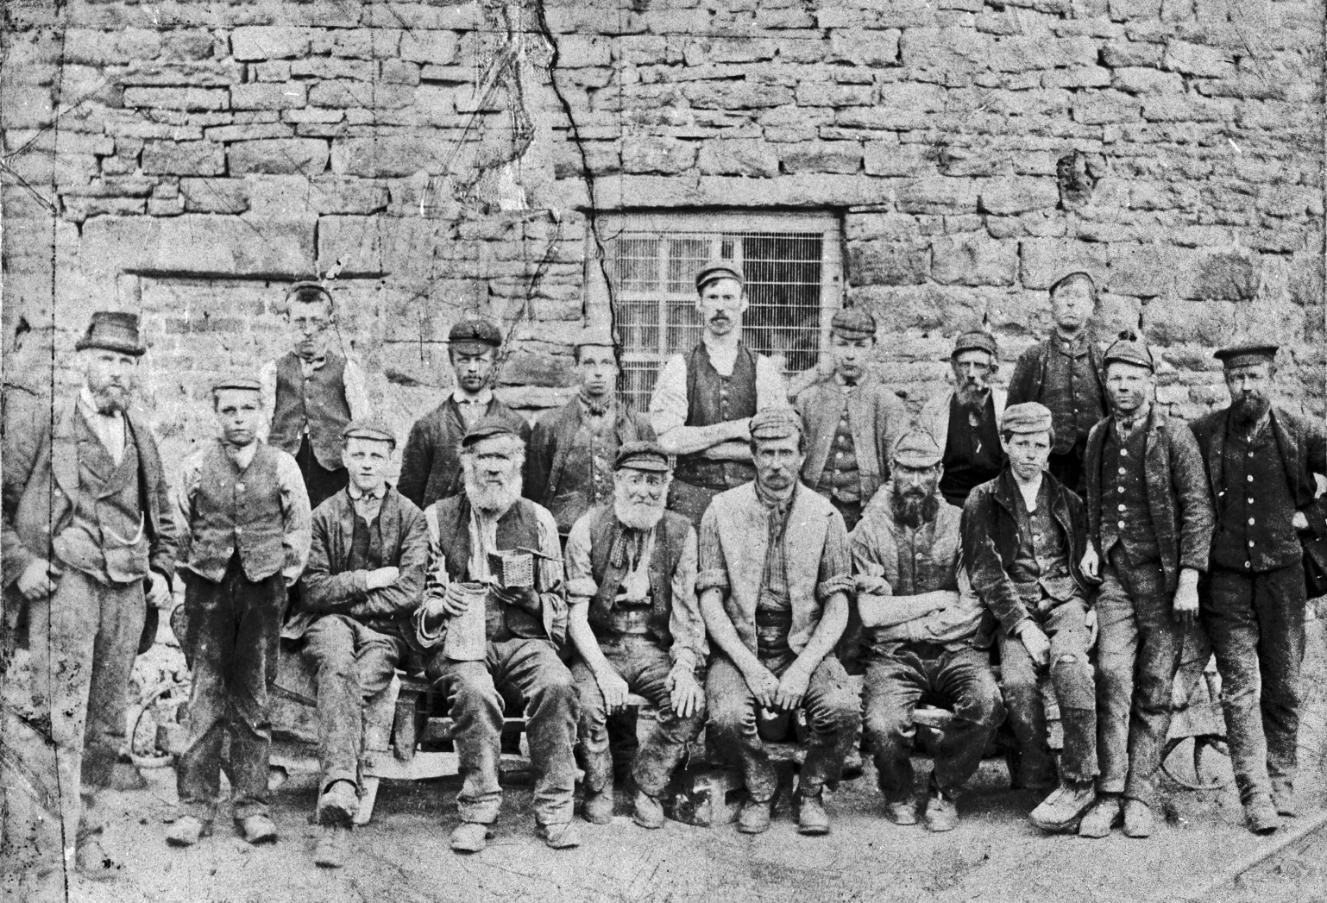
MINING Places 3
Lead mining group, date unknown. The People’s Collection. Credit: Reproduced by permission of Beamish Museum Ltd.

Slide 12
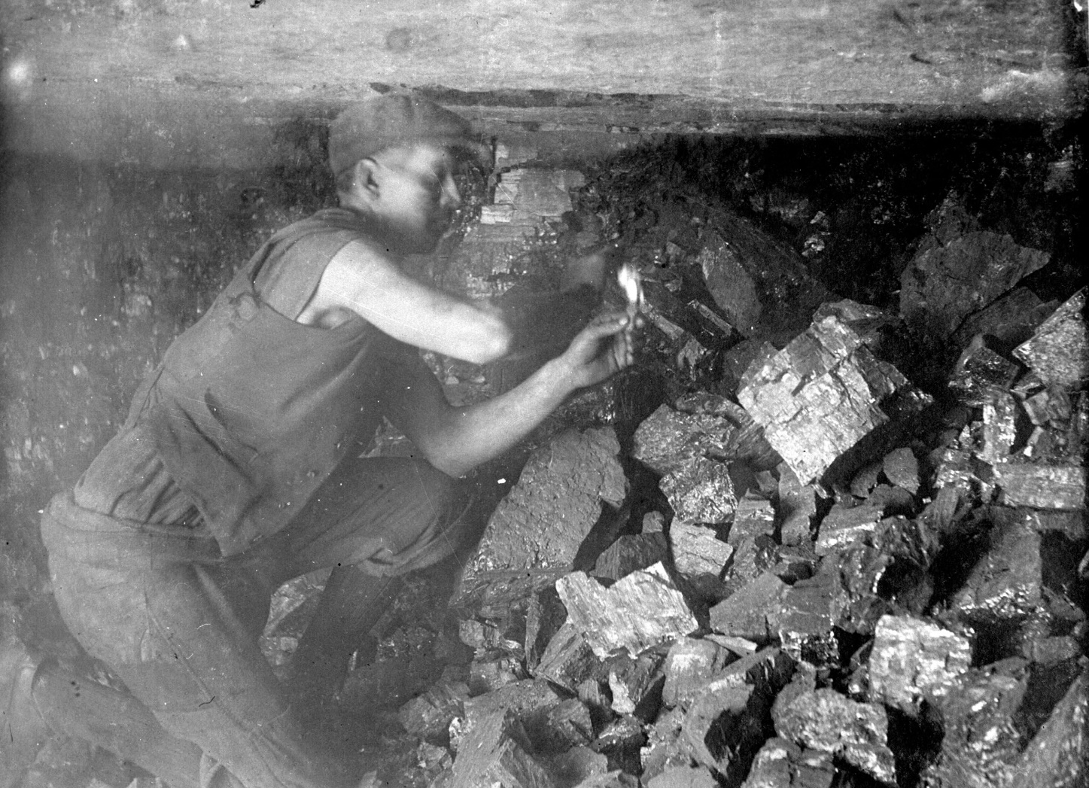
MINING Places 4
A miner examining the situation after a coal blast. Ashington Colliery, Northumberland, c. 1910. From an album produced by Ashington Coal Co, 1911. The People’s Collection. Credit: Reproduced by permission of Beamish Museum Ltd.

Slide 13
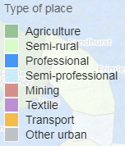
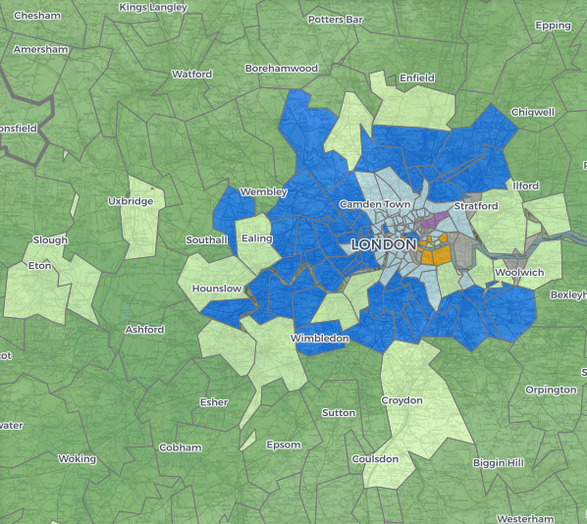
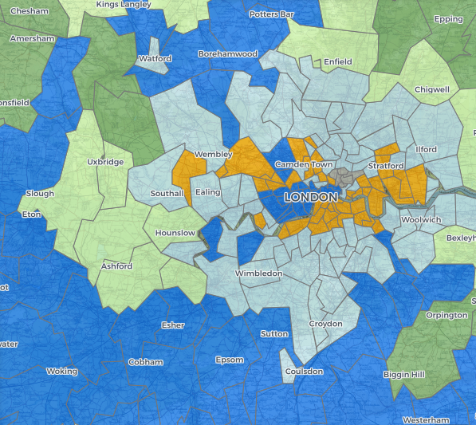
PROFESSIONAL Places
In 1851 professional areas occupied a tight horseshoe shape around western London, from Walthamstow in the North-East to Eltham in the South-East, taking in districts such as Hampstead, Hendon, Kensington, Wimbledon and Brixton.
Over time this expanded and gradually moved outwards, so that by 1911 most of Surrey and eastern Berkshire were classed as PROFESSIONAL.
The only areas in London to remain in the PROFESSIONAL category throughout were in the west: including Mayfair, South Kensington and Belgravia.
Outside of London, other places, such Clifton in Bristol and Edgbaston in Birmingham, also had small areas which could be classed as PROFESSIONAL from early on, and the number of these places grew dramatically across the period.
PROFESSIONAL places are defined by larger than average numbers of people working in professional occupations, including doctors, lawyers, and teachers, and also above average numbers of servants to keep house for them. Many of these professional people will have commuted to city centres to work.
1851
1911
The expansion of PROFESSIONAL areas around London

Slide 14
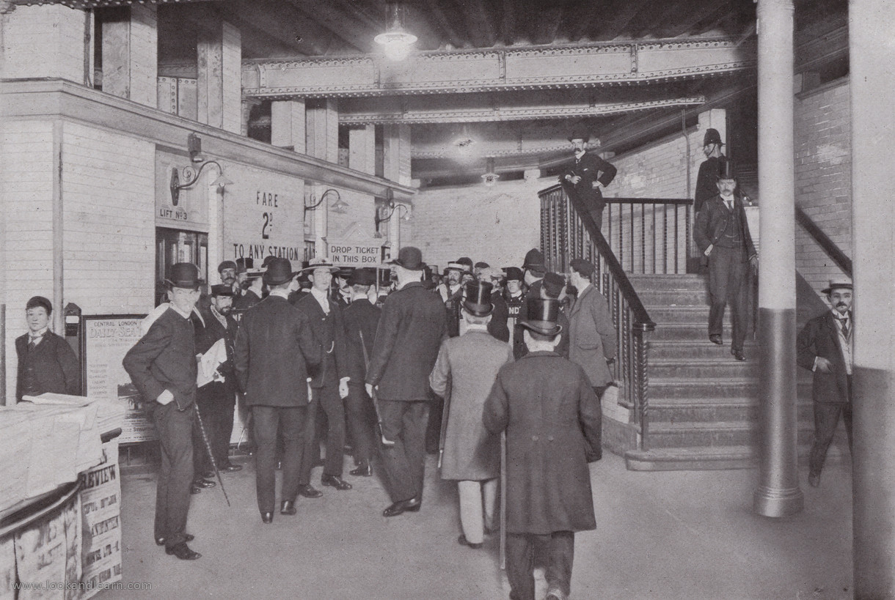
PROFESSIONAL Places 1
At the Bank Station of the Central London Railway, Entrance, 1896. Illustration for Pictorial London (Cassell, c. 1905). A reprint of The Queen's London (1896), with some additional photographs. Credit: Reproduced by permission of Look and Learn History Picture Library www.lookandlearn.com

Slide 15
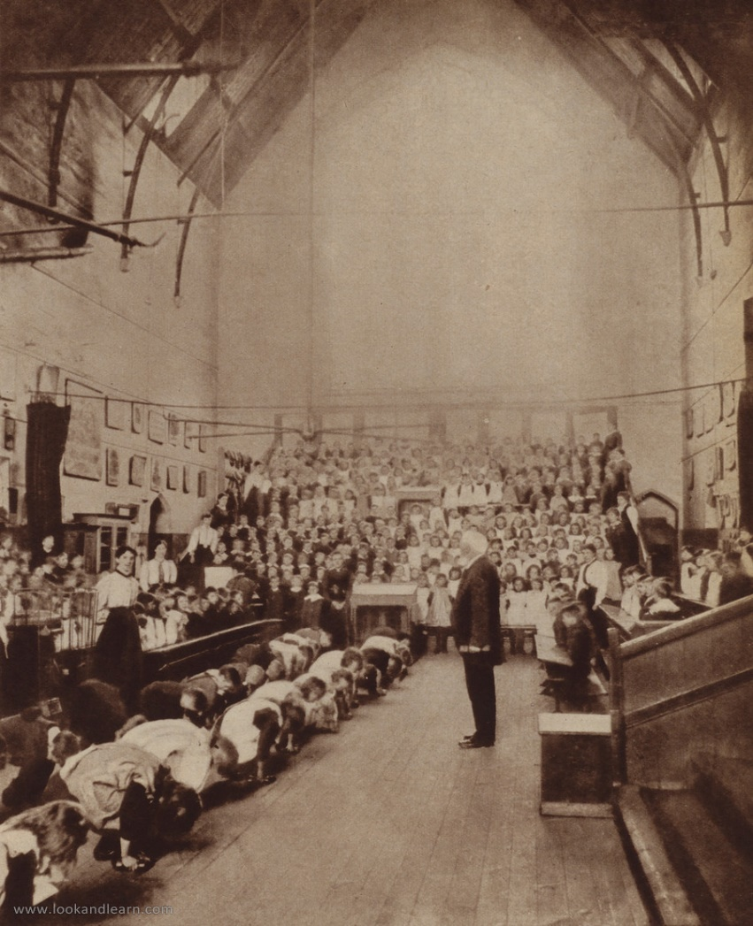
PROFESSIONAL Places 2
Elementary School, England, c. 1890. From 1930s reproduction of photograph. Credit: Reproduced by permission of Look and Learn History Picture Library www.lookandlearn.com

Slide 16
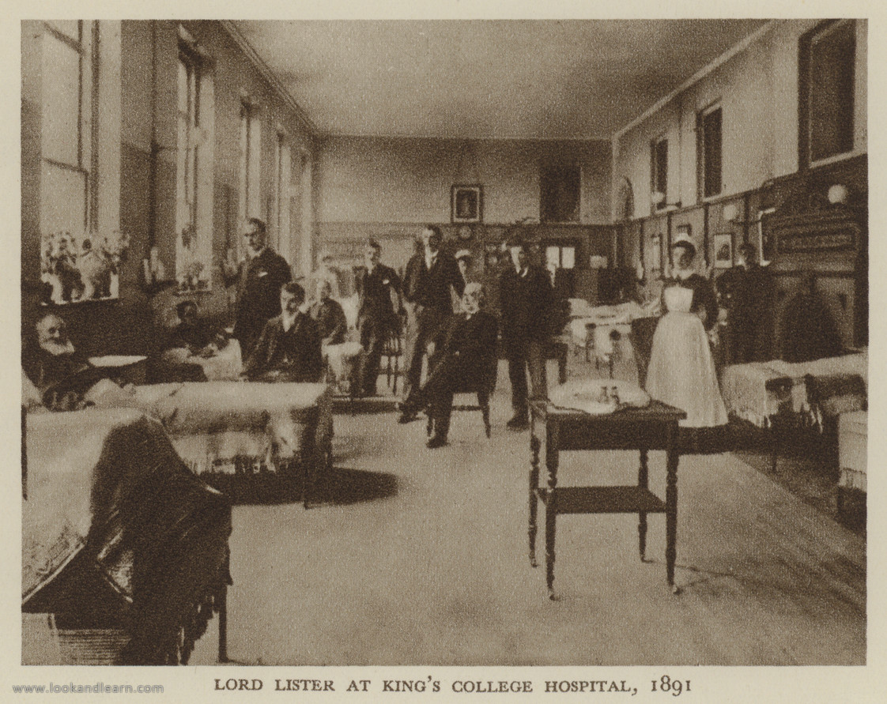
PROFESSIONAL Places 3
Lord Lister at King's College Hospital, 1891. Illustration for Fifty Years: Memories and Contrasts by twenty seven contributors to The Times (Thornton Butterworth, 1932). Credit: Reproduced by permission of Look and Learn History Picture Library www.lookandlearn.com

Slide 17
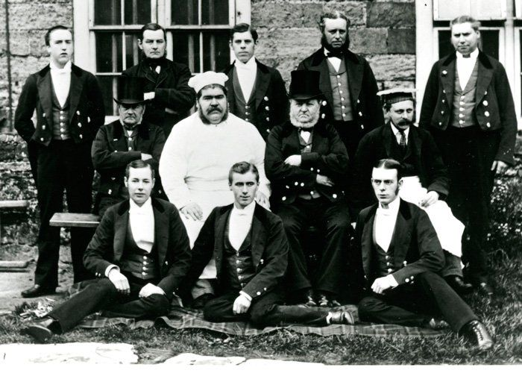
PROFESSIONAL Places 4
Male servants at Petworth House, West Sussex, c. 1870s. Picture includes: steward, footmen, chefs, lodge keepers and butlers. The Kevis Collection.
Credit: Reproduced by permission of West Sussex Record Office

Slide 18
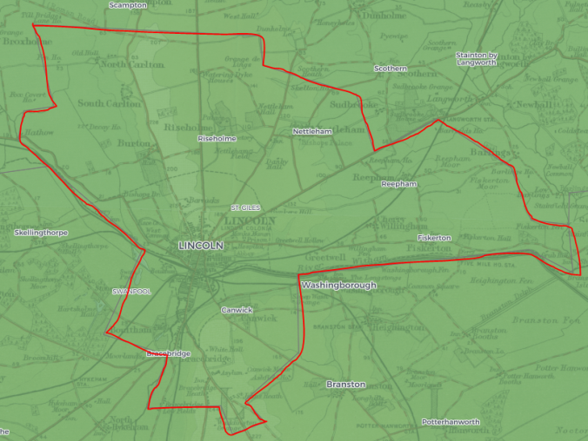
AGRICULTURAL Places
Registration Sub-Districts with low overall population density and over 5% of the population working in agriculture were designated as AGRICULTURAL places.
These districts contained villages and small towns. Even some larger towns in subdistricts which also had a large rural hinterland were designated as AGRICULTURAL: this was the case for Eastbourne, Lincoln, Peterborough and Harrogate until 1881.
There were AGRICULTURAL places in every part of the country, but the type of agriculture varied. In Wales, and in the North and the South West of England (photographs 1-7), family farms were common, with little hired labour. In the South and East of the country (photograph 8) farms tended to be larger and to rely on agricultural labourers.
Lincoln Sub-District: AGRICULTURAL until 1881 due to the large rural hinterland around the city

Slide 19
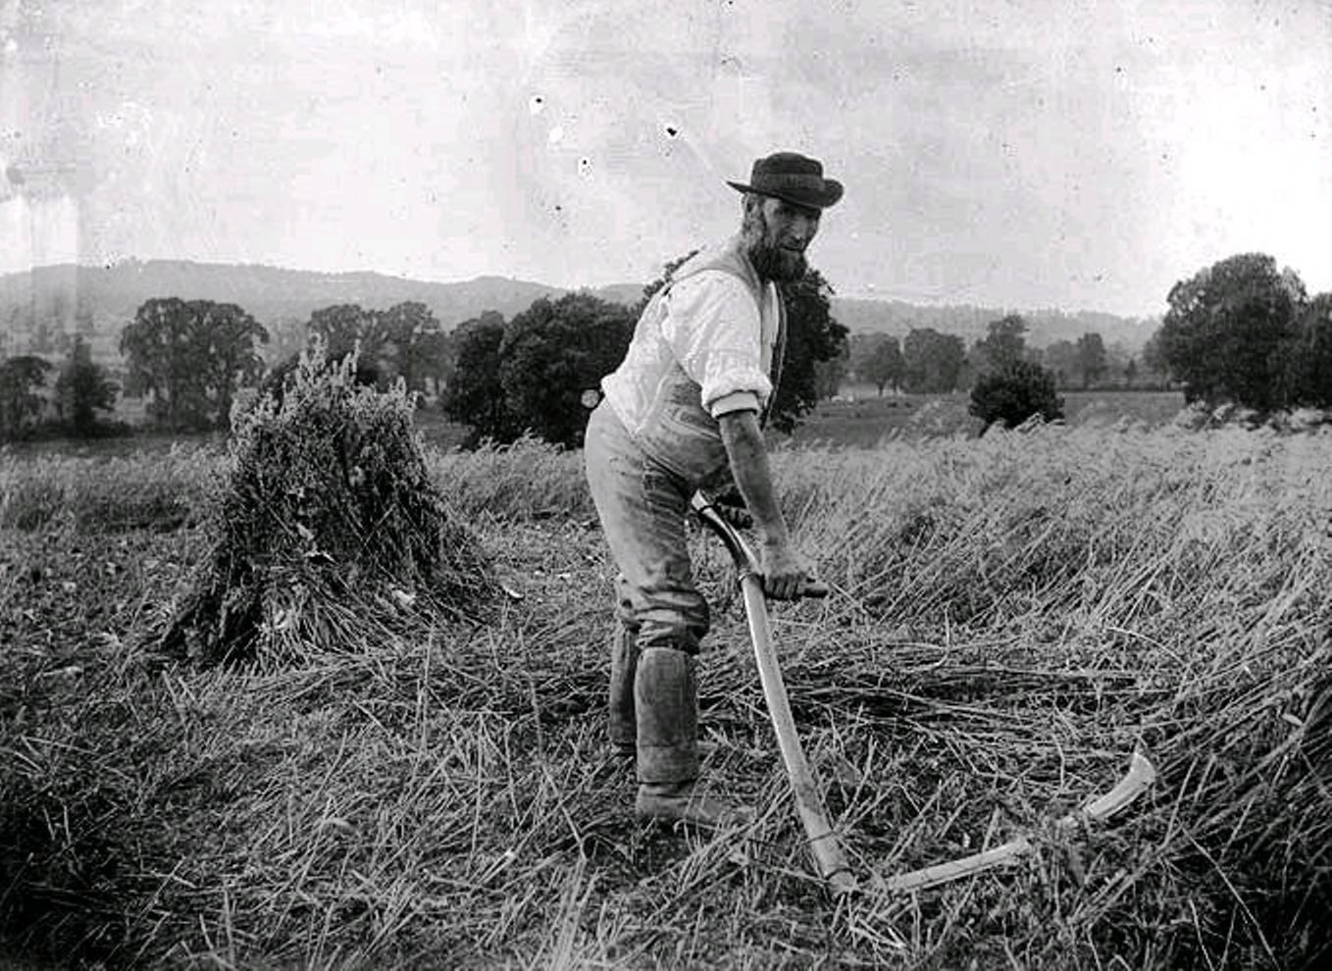
AGRICULTURAL Places 1
Agricultural labourer working with a scythe, c. 1900. Public domain. Credit: Prior to Now, Over 250 Years on Combe Down (Devon) www.combedown.org

Slide 20
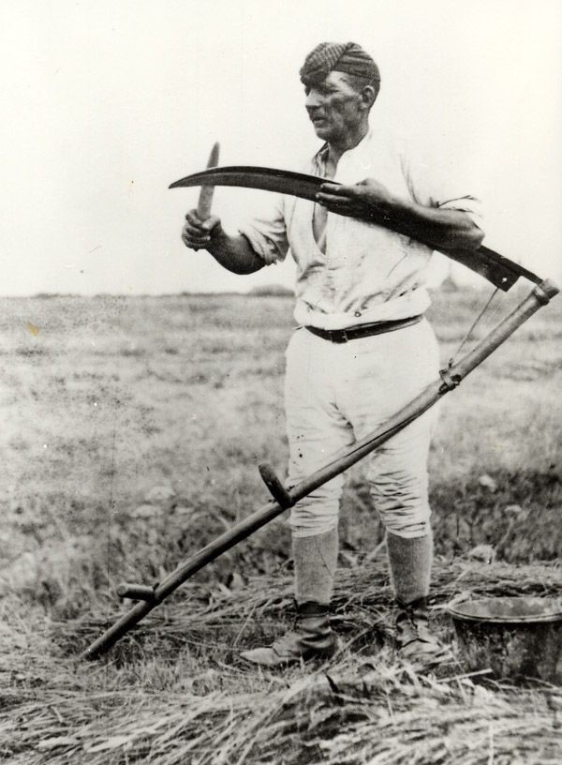
AGRICULTURAL Places 2
Harry Wilkinson sharpening a scythe, wearing a checked cap, open shirt and breeches, c. 1890.
Credit: Reproduced by permission of The Village Church Farm, Skegness, PE25 2HF www.churchfarmvillage.org.uk

Slide 21
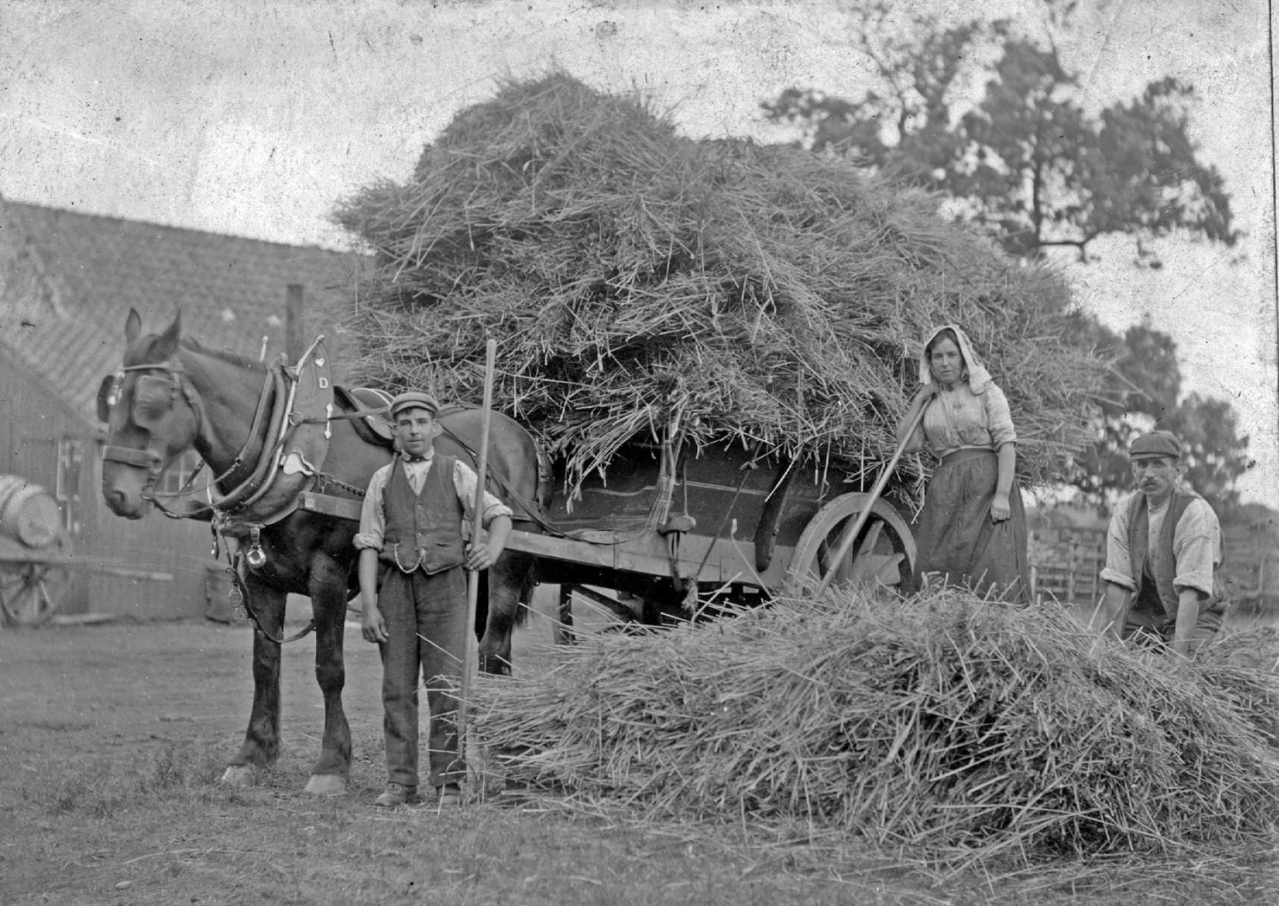
AGRICULTURAL Places 3
Loading hay on to a horse and cart at a farm near Bishop Auckland, Co. Durham, c. 1900s. The People’s Collection. Credit: Reproduced by permission of Beamish Museum Ltd.

Slide 22
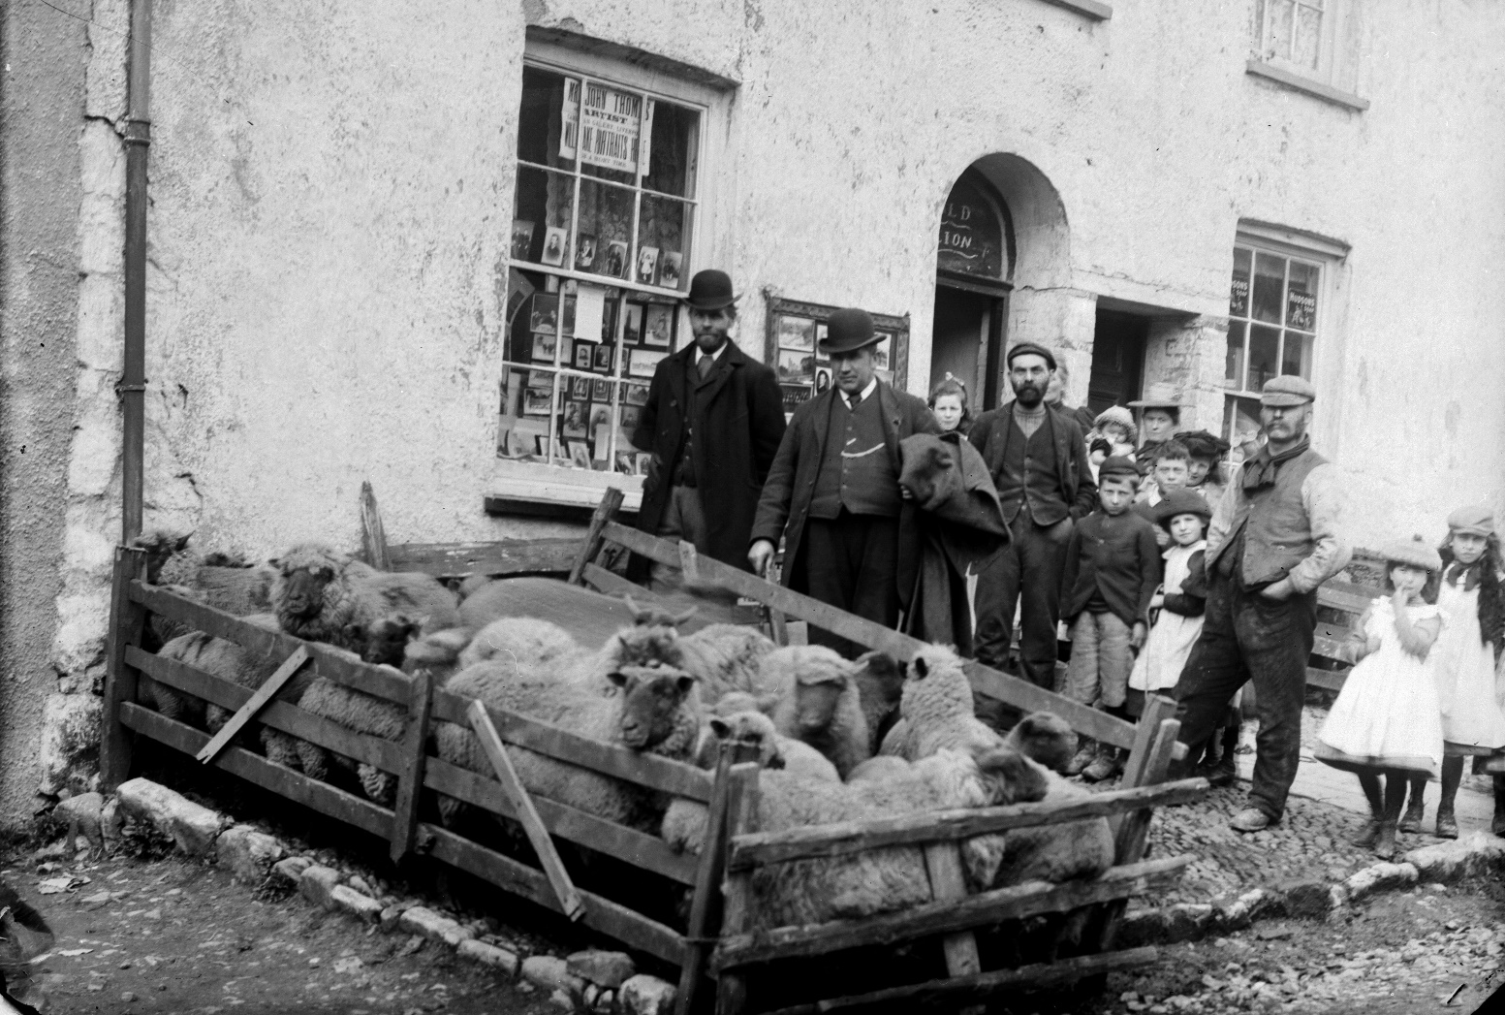
AGRICULTURAL Places 4
Sheep mart, Narberth, c. 1885.
John Thomas Photographic Collection. Credit: By permission of Llyfrgell Genedlaethol Cymru / The National Library of Wales.

Slide 23
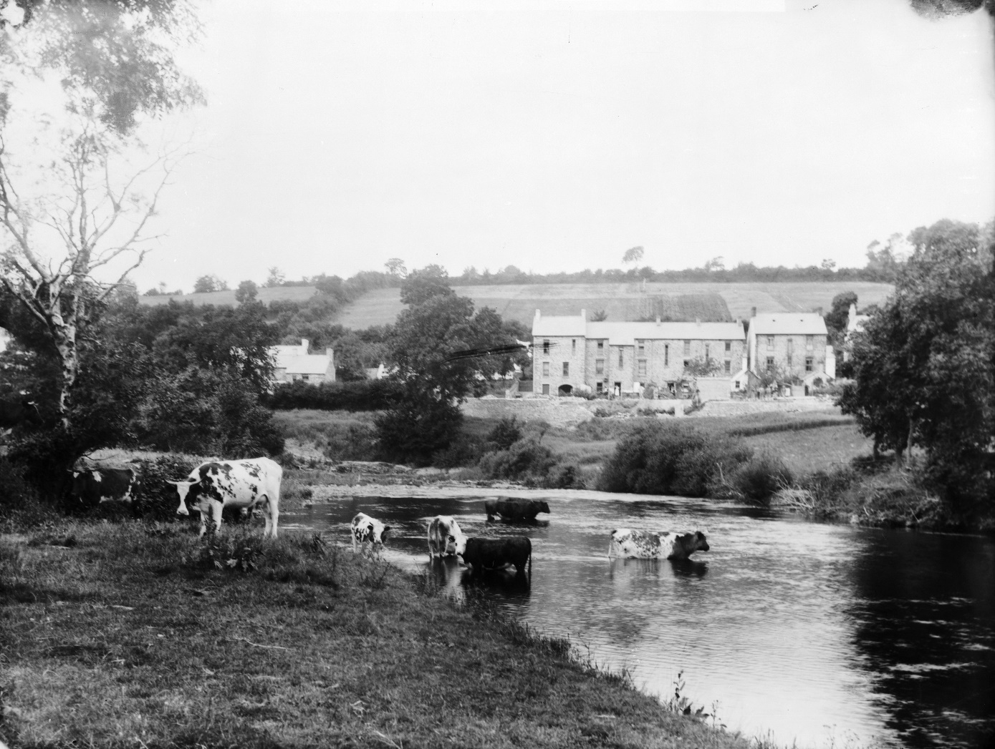
AGRICULTURAL Places 5
Cattle by the river, Llandysul (Cer), c. 1885.
John Thomas Photographic Collection. Credit: By permission of Llyfrgell Genedlaethol Cymru / The National Library of Wales.

Slide 24
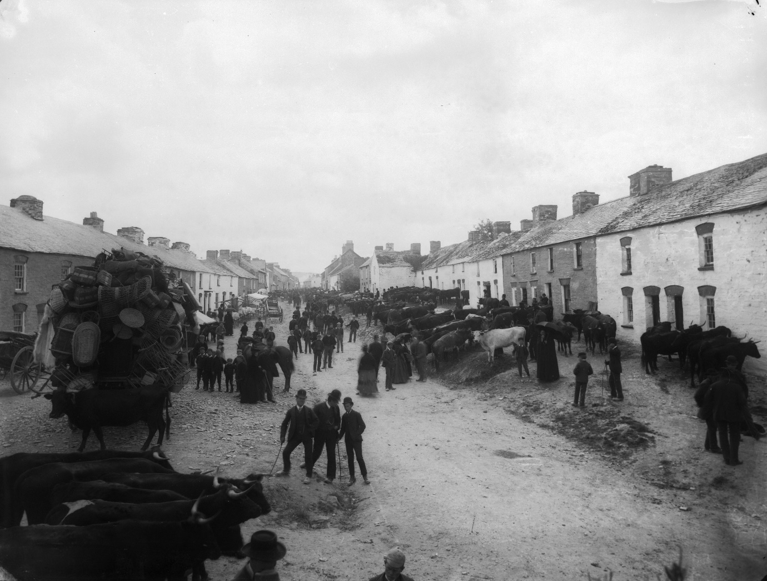
AGRICULTURAL Places 6
Cilgerran fair, c. 1885.
John Thomas Photographic Collection. Credit: By permission of Llyfrgell Genedlaethol Cymru / The National Library of Wales.

Slide 25
AGRICULTURAL Places 7
Hand milking, West Camel, Somerset, date unknown.
Credit: Reproduced by permission of The Museum of English Rural Life, University of Reading.

Slide 26
AGRICULTURAL Places 8
Sulham Farmyard, 1884.
Credit: Reproduced by permission of The Museum of English Rural Life, University of Reading.

Slide 27
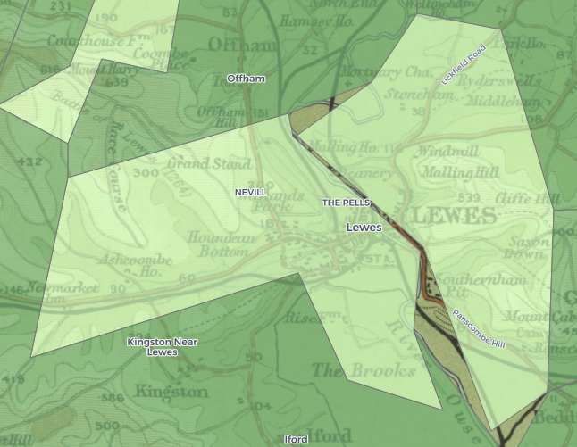
SEMI-RURAL Places
Districts were classed as SEMI-RURAL if they had a higher population density than agricultural districts, but still a significant number of agricultural workers.
SEMI-RURAL districts tended to contain both rural and urban areas, with a more urban balance than agricultural areas.
As towns and cities grew, many areas went through a SEMI-RURAL stage: for example the Sub-District of Lincoln Home was AGRICULTURAL until 1881, SEMI-RURAL in 1881 and 1891, and SEMI-PROFESSIONAL thereafter.
Some districts containing stable market towns remained SEMI-RURAL throughout the period; for example Bideford, Devon; Dartmouth, Devon; Boston, Lincolnshire; and Berwick-on-Tweed, Northumberland.
Some areas changed designation due to boundary change: for example the Sub-District of Lewes, Sussex was SEMI-RURAL until 1901 when the boundary expanded to include a predominantly rural area, leading to an AGRICULTURAL designation in 1901 and 1911.
The Registration Sub-District of Lewes, Sussex: a market town and rural surroundings.

Slide 28
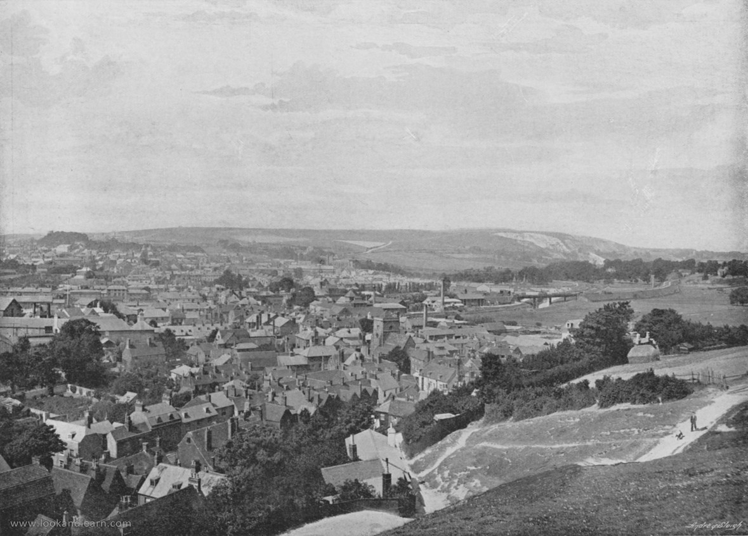
SEMI-RURAL Places 1
Lewes, c. 1895. Illustration for Pictorial England and Wales (Cassell, c. 1895).
Credit: Reproduced by permission of Look and Learn History Picture Library www.lookandlearn.com

Slide 29
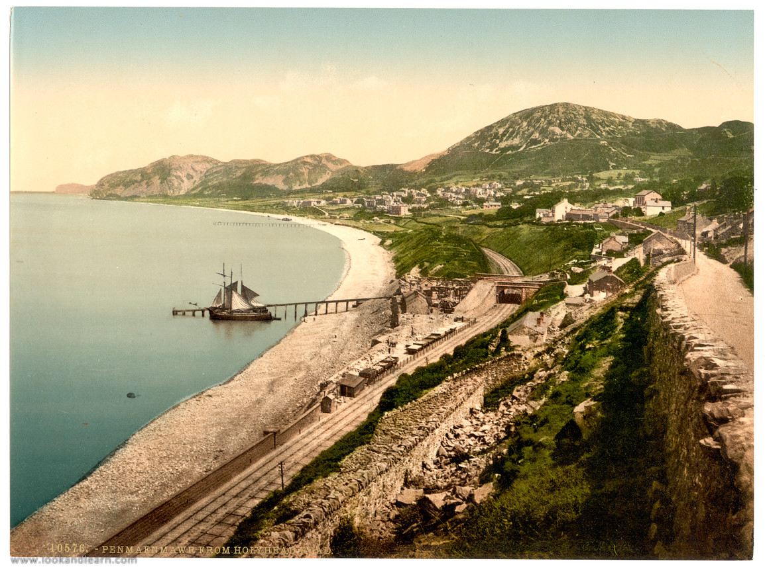
SEMI-RURAL Places 2
From Holyhead Road, Penmaenmawr, Wales. Date between c. 1890 and c. 1900. Credit: Reproduced by permission of Look and Learn History Picture Library www.lookandlearn.com
Notes:
The Registration Sub-District of Conway, containing the town of Penmaenmawr, contained too large a rural hinterland to ever place it in the SEMI-RURAL category. However we have included this photograph as it nicely illustrates the 'town in an rural area' characteristic of SEMI-RURAL areas.

Slide 30
SEMI-RURAL Places 3
Horse Fair, Alfreton, c. 1906.
From postcard with postmark 1906.
Credit: Reproduced by permission of The Museum of English Rural Life, University of Reading.

Slide 31
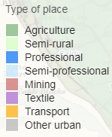
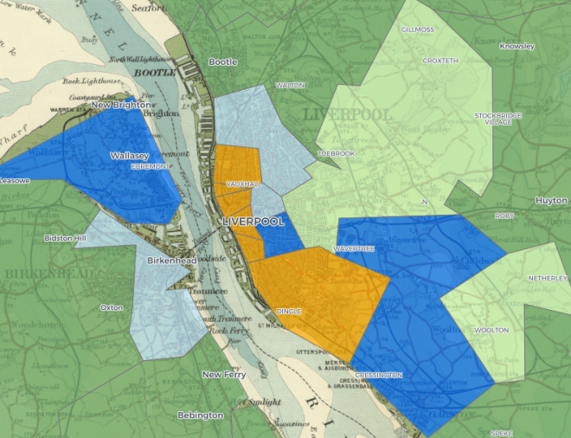
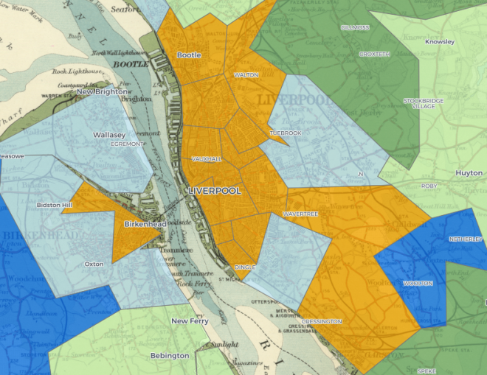
TRANSPORT Places
Districts where at least 15% of workers were working in transport-related occupations were designated as TRANSPORT.
In 1851, most TRANSPORT places were dominated by dockyard workers; for example Toxteth Park, Liverpool; Rotherhithe, East London; and St Mary, Hull. Over time docking grew in importance, and neighbouring districts also became classed as TRANSPORT.
There was a rapid growth in railways over the second half of the 19th century, and places involved in the building and servicing of trains and railways became at least temporarily classed as TRANSPORT; for example Doncaster (1891-1901); Micklegate, York (1881-1901); Kentish Town & St Pancras in London (from 1881).
When goods arrived by sea and by rail, they needed temporary storage in warehouses, and onward transport by road. Road transport workers and storage workers were found throughout TRANSPORT districts, but car- and cab-men were particularly important in parts of London, where they were also important in transporting people throughout the city.
The canal network was established in the late 18th and early 19th century, and although it did not expand further, it remained an important part of the transport network.
1851
1911
The growth of the transport industry in Liverpool

Slide 32
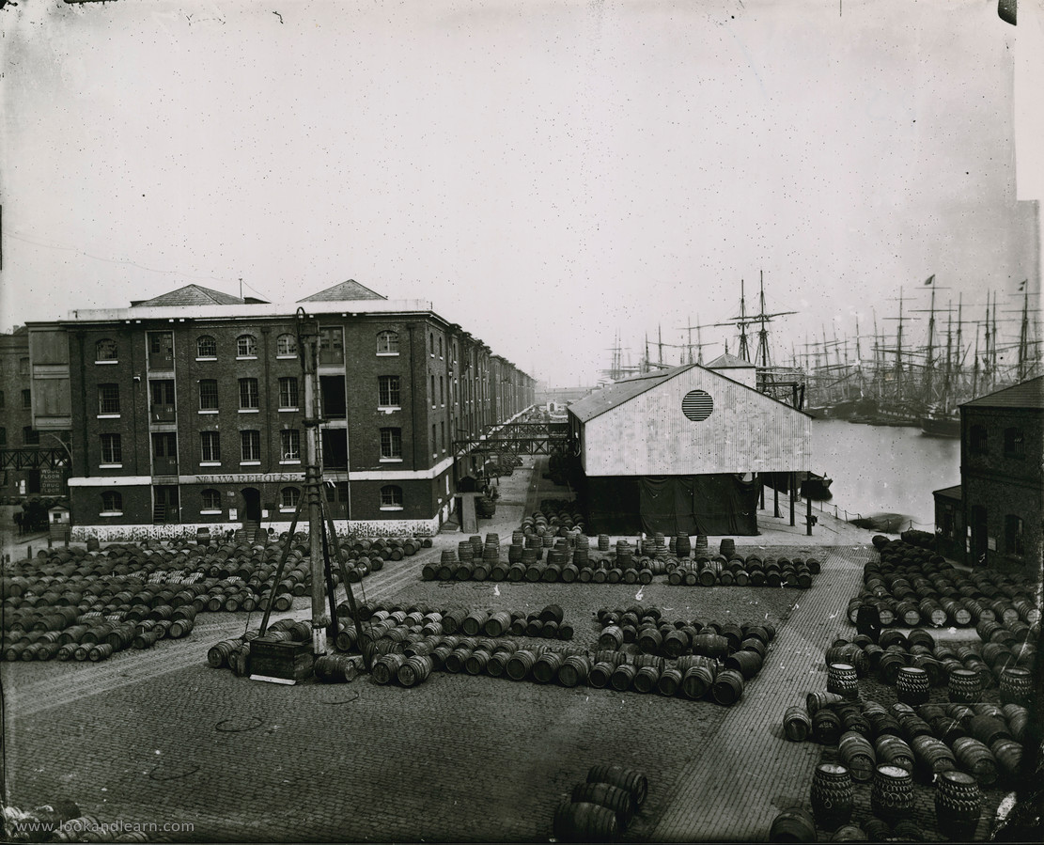
TRANSPORT Places 1
London Docks, date unknown. Credit: Reproduced by permission of Look and Learn History Picture Library www.lookandlearn.com

Slide 33
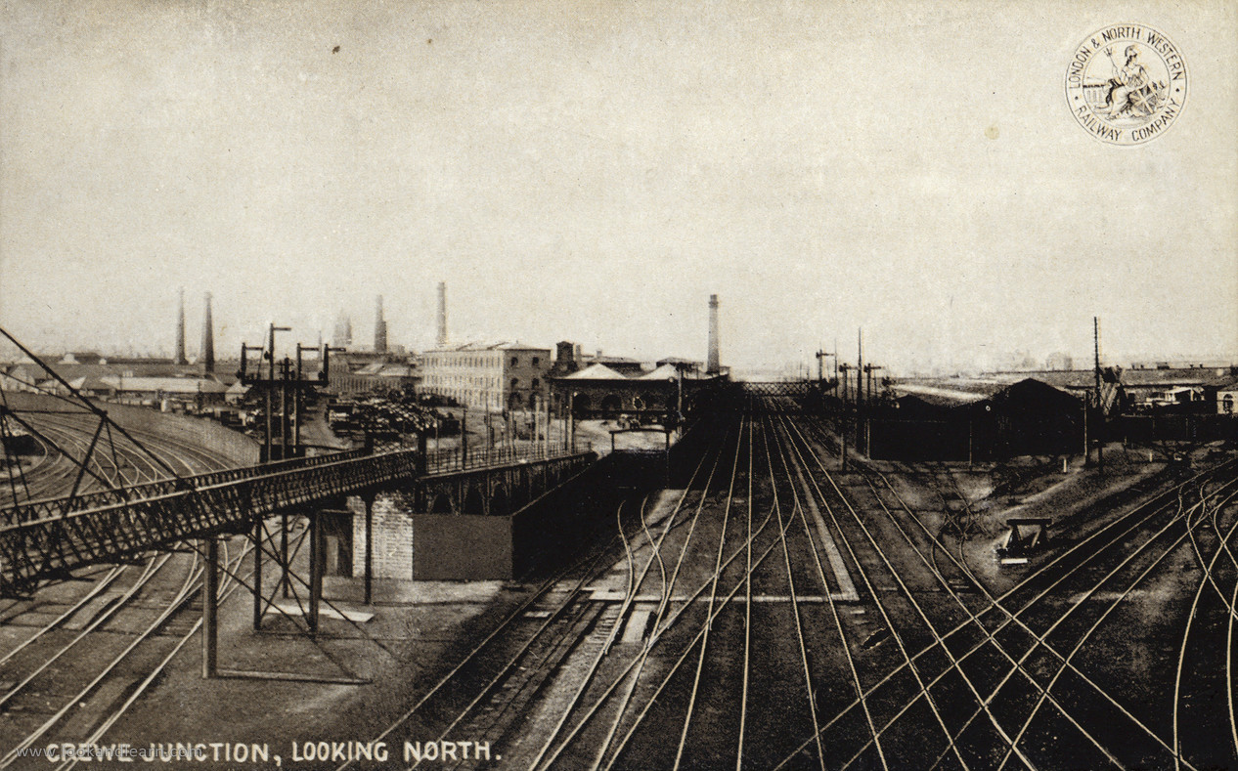
TRANSPORT Places 2
Crewe Junction, looking north, date unknown. Credit: Reproduced by permission of Look and Learn History Picture Library www.lookandlearn.com
Notes:
The town of Crewe was a very important centre for the railway industry, but the Registration Sub-District (called Wynbunbury between 1851 and 1881, and Crewe from 1891 to 1911) was set in a large rural hinterland which meant it was always classed as AGRICULTURAL or SEMI-RURAL. However we have included this photograph here as it nicely illustrates a busy railway junction.

Slide 34
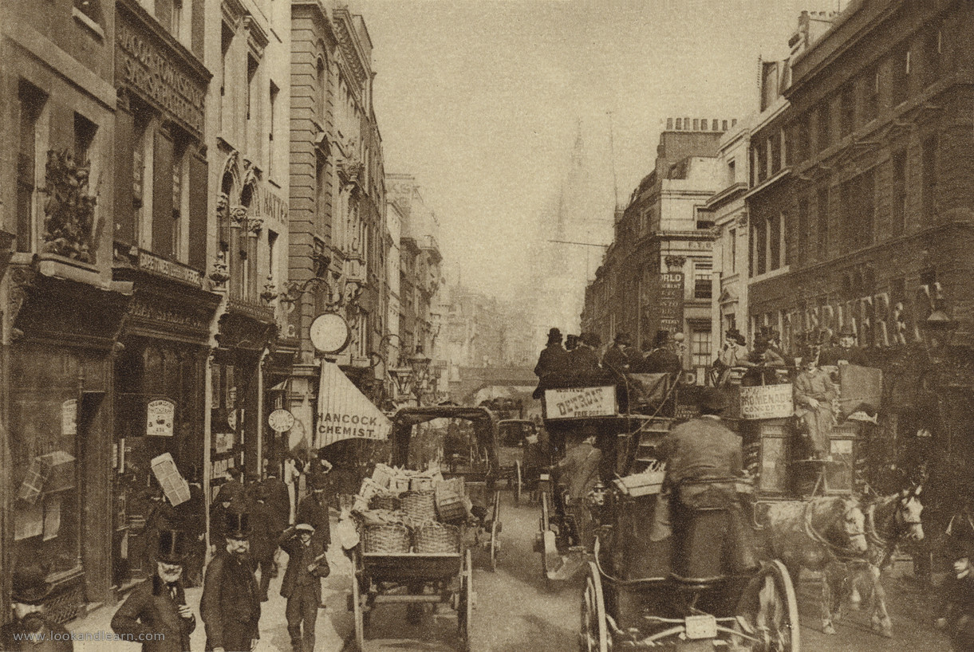
TRANSPORT Places 3
Fleet Street, 1880. Illustration for Wonderful London by St John Adcock (Fleetway, c. 1930). Credit: Reproduced by permission of Look and Learn History Picture Library www.lookandlearn.com

Slide 35
TRANSPORT Places 4
Canal workers, 1877. Workers on the “Silent Highway”. From 'Street Life in London', 1877, by John Thomson and Adolphe Smith. Provided by LSE Library under a CC BY-NC-SA 3.0 licence, https://digital.library.lse.ac.uk/objects/lse:doq917suy

Slide 36
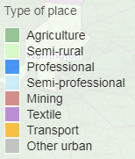
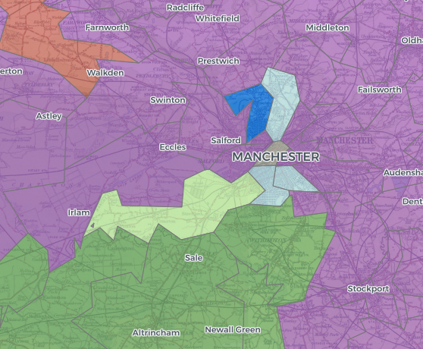
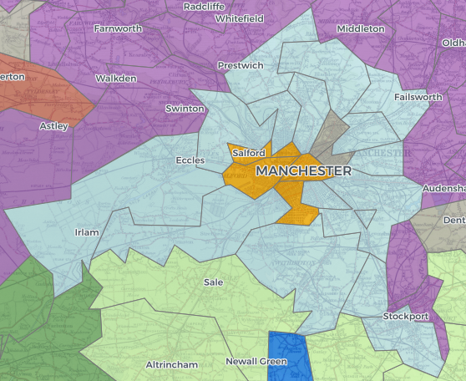
SEMI-PROFESSIONAL Places
Like PROFESSIONAL areas, places designated as SEMI-PROFESSIONAL contained a significant number of people working in professional occupations. However they contained a lower number of people working as servants than PROFESSIONAL areas.
The middle classes were growing rapidly over the late 19th century, and as the wealthier members moved out to the suburbs and beyond, their former homes were occupied by the lower middle classes. Expanding doughnuts of SMEMI-PROFESSIONAL areas can be seen around cities large enough to comprise many sub-districts. Examples include London, Manchester, Leeds and Birmingham.
Smaller cities and county towns which provided services for a large rural area were often also entirely or partially classed as SEMI-PROFESSIONAL. Examples include Lancaster and Kendal from 1871, and the western part of Norwich.
1851
1911
The growth of Manchester's SEMI-PROFESSIONAL suburbs

Slide 37
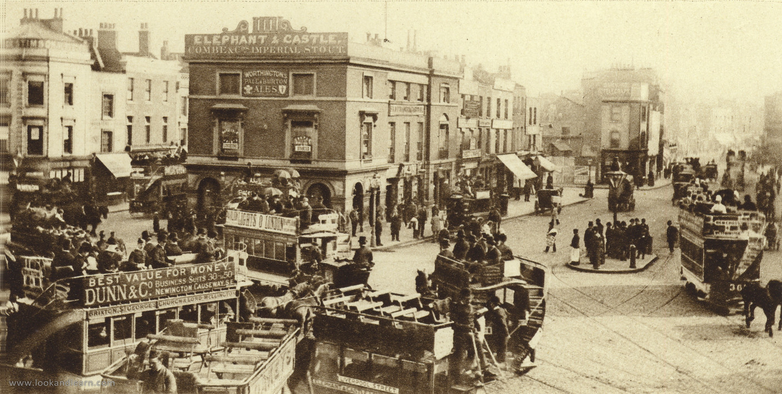
SEMI-PROFESSIONAL Places 1
Elephant and Castle, Southwark, in the late 19th century. Illustration for Wonderful London by St John Adcock (Fleetway, c. 1930). Credit: Reproduced by permission of Look and Learn History Picture Library www.lookandlearn.com

Slide 38
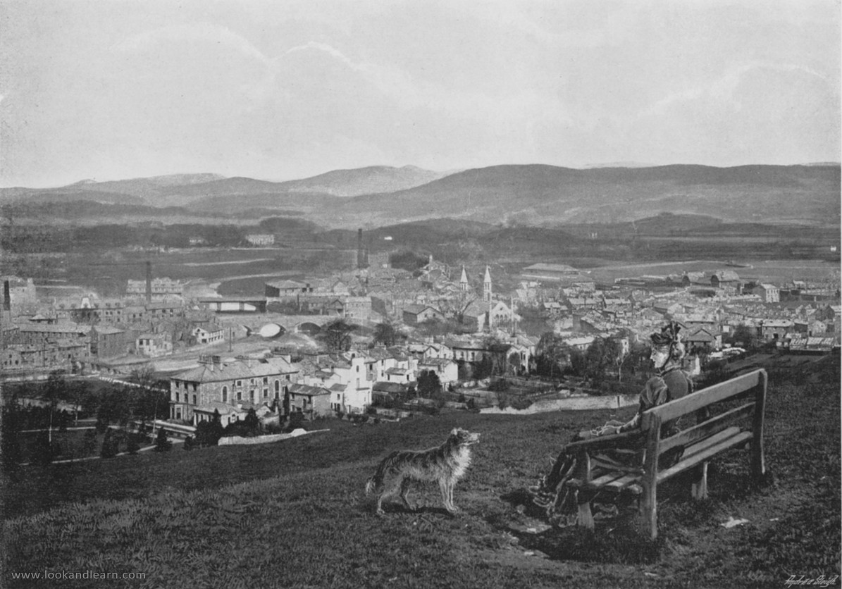
SEMI-PROFESSIONAL Places 2
Kendal, from the Castle, c. 1895. Illustration for Pictorial England and Wales (Cassell, c. 1895).
Credit: Reproduced by permission of Look and Learn History Picture Library www.lookandlearn.com

Slide 39
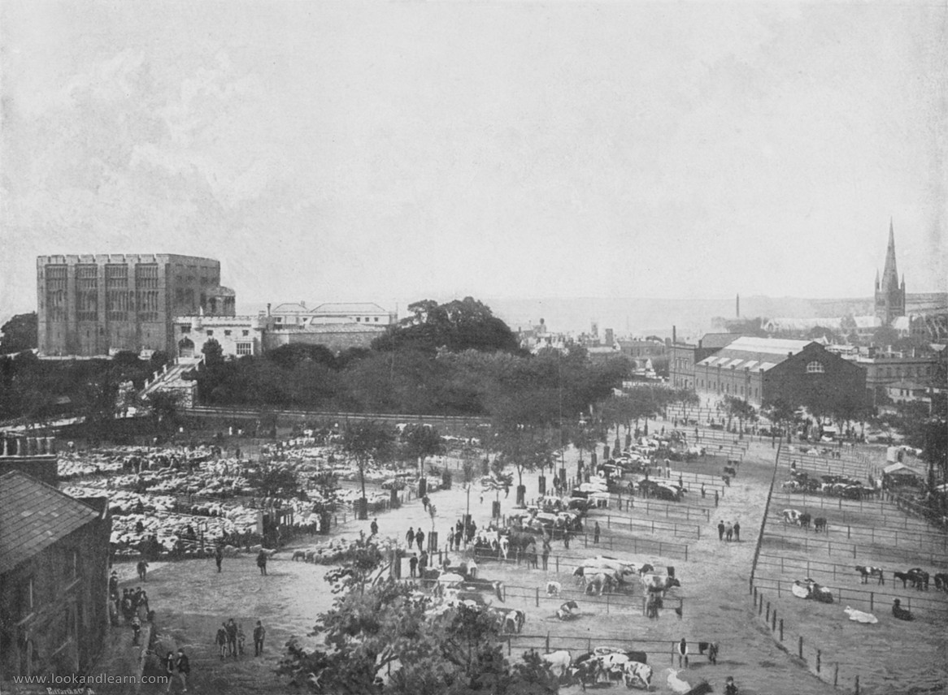
SEMI-PROFESSIONAL Places 3
Norwich, Castle, Cattle Market, and Cathedral, c. 1895. Illustration for Pictorial England and Wales (Cassell, c. 1895). Credit: Reproduced by permission of Look and Learn History Picture Library www.lookandlearn.com

Slide 40
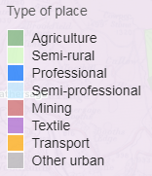
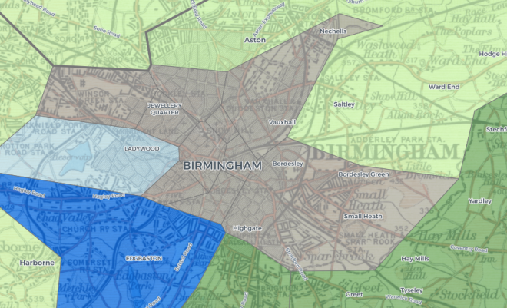
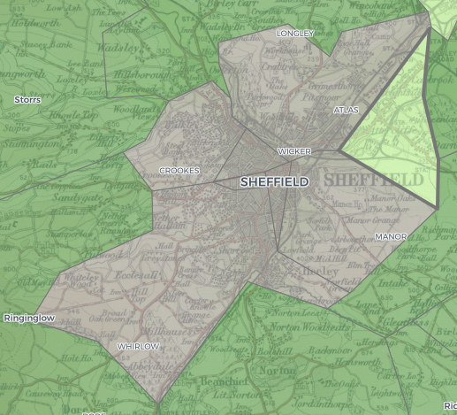
OTHER URBAN Places
'OTHER URBAN' districts are those that are not included in any of the other categories. They are all urban because they have relatively high population densities, and their inhabitants were mainly working class people.
Some such places were dominated by a particular industry, such as pottery in Stoke-on-Trent, but in most places, such as Birmingham and Sheffield, there was a variety of industries.
1851
Birmingham
1851
Sheffield

Slide 41
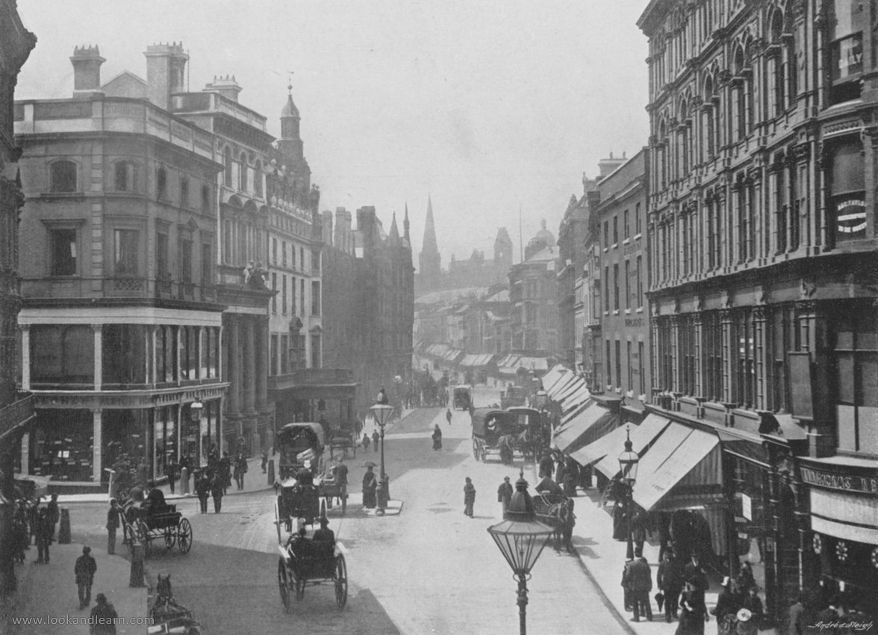
OTHER URBAN Places 1
New Street, Birmingham, c. 1895. Illustration for Pictorial England and Wales (Cassell, c. 1895). Credit: Reproduced by permission of Look and Learn History Picture Library www.lookandlearn.com

Slide 42
OTHER URBAN Places 2
Double Deck Horse Drawn Tram No. 1 at Nether Edge Depot Yard, Sheffield, 1886.
Credit: Reproduced by permission of Sheffield Libraries and Archives http://www.picturesheffield.com/

Slide 43
OTHER URBAN Places 3
South Street, Moor, at junction with Earl Street, right, Sheffield, 1887. Credit: Reproduced by permission of Sheffield Libraries and Archives http://www.picturesheffield.com/

Slide 44
OTHER URBAN Places 4
People from a poor area of Victorian Sheffield, date unknown. Credit: Reproduced by permission of Sheffield Libraries and Archives http://www.picturesheffield.com/

Slide 45
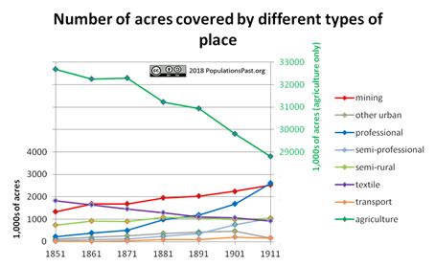
Overview - area
In terms of area, both England and Wales were still predominantly agricultural in the late nineteenth and early twentieth centuries. However agricultural areas were sparsely populated: the bulk of the population already lived in towns and cities. In the years leading up to the dawn of the twentieth century the process of urbanisation continued, so that by 1901 over 80 per cent of the population of England and Wales lived in urban areas. Urban populations could grow by three different processes: natural increase (an excess of births over deaths) in urban areas, migration of rural-dwellers into towns and cities, or the re-classification of areas as urban. This last process, ‘extension’ or ‘urban sprawl’, was predominantly due to the expansion of the built up area into the surrounding country side. If people moved out of crowded city centres to less densely populated suburbs then this process could be associated with a decline in the population density of inner city areas. The maps on the website, and this graph of the number of acres covered by different types of place, show the latter process clearly, with the gradual spread of non-green colours across the maps indicating change in the character of areas. This is particularly noticeable in the area around London: PROFESSIONAL and SEMI-PROFESSIONAL areas can be seen to radiate out from the city with the passage of time.

Slide 46
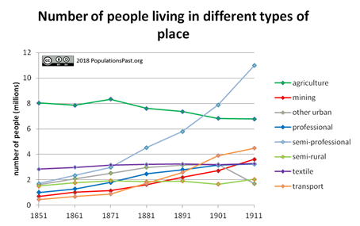
Overview - population
Although the growth of PROFESSIONAL places is particularly noticeable on the maps, it was actually the SEMI-PROFESSIONAL places which saw the largest increase in their population. There were approximately 8 million people living in AGRICULTURAL areas in 1851, but this number had declined to 6.8 million people by 1911; a fall of around 15 per cent. However because the total population of England and Wales almost doubled over the same period, the percentage of the total population living in AGRICULTURAL areas fell from 45 to 20 per cent.
Examination of the maps shows that some of the types of area were very geographically concentrated, notably TEXTILE and MINING areas. Others, such as TRANSPORT and OTHER URBAN were spread around the country and are harder to identify on the maps.

